Slide 1
Tourism Project Topic: Ellora Caves
Presentation by
Asvini Kumar Pandey
Class XII

Slide 2
Content
Introduction
Historical Significance
Kailasa Temple
Location
Routes
Route from Porbandar
Conclusion
Further Reads

Slide 3
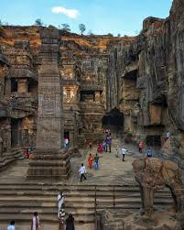
Introduction
Located in the Sahyadri hills of Maharashtra, India.
Complex of 34 rock-cut temples and monasteries.
Carved between the 6th and 10th centuries AD.
Designated as a UNESCO World Heritage Site.
Showcases the coexistence and spiritual harmony of Buddhism, Hinduism, and Jainism.
Represents exceptional architectural mastery.
Serves as a living testament to India’s cultural and religious unity.

Slide 4
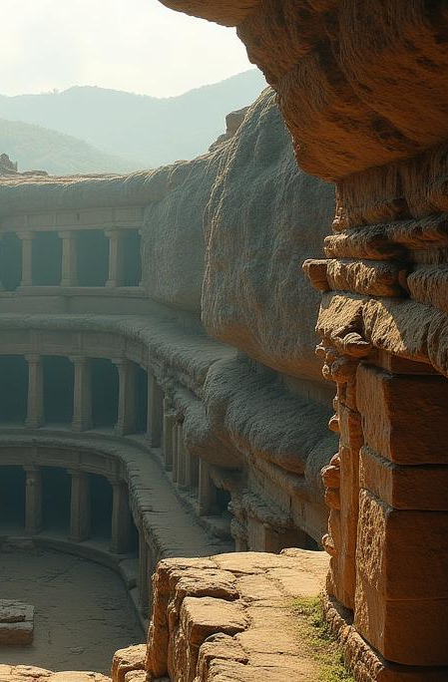
01
Overview

Slide 5
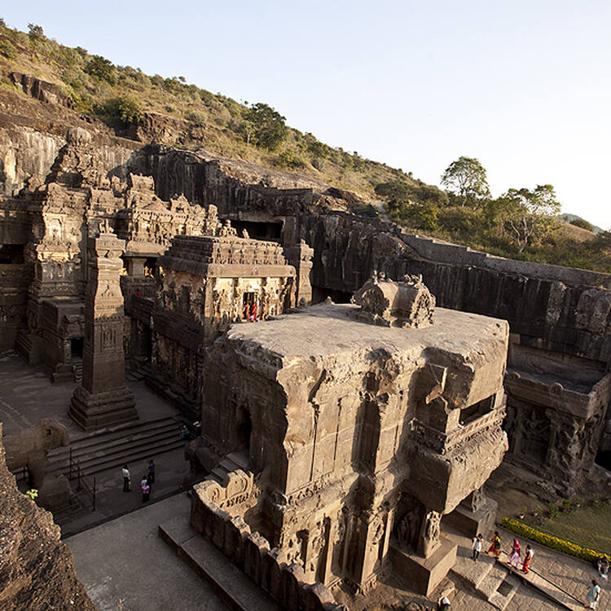
Historical Significance
Reflect over 400 years of artistic and religious evolution in India.
Built under the Rashtrakutas, Kalachuris, and Yadavas, showing the evolution of art, faith, and architecture.
Feature Buddhist, Hindu, and Jain monuments carved side by side, symbolizing religious tolerance.
The Kailasa Temple (Cave 16) with its unprecedented monolithic construction.
One of the most important heritage sites in Asia.

Slide 6
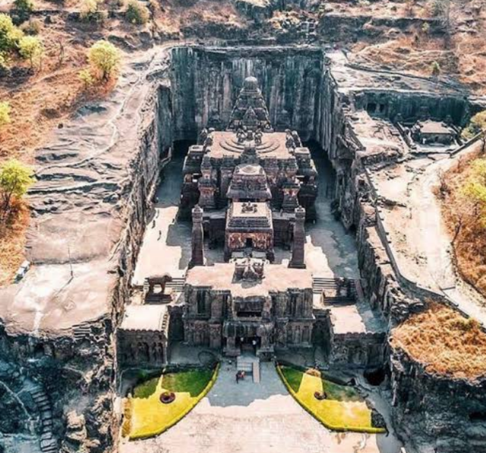
Kailasa Temple (Cave 16)
World’s largest monolithic rock-cut temple, carved from a single rock.
Built during the Rashtrakuta dynasty in the 8th century CE.
Dedicated to Lord Shiva.
Took about 100 years to complete, with 200,000 tons of rock removed using basic tools.
Features intricate carvings depicting scenes from the Ramayana and Mahabharata.
Exhibits perfect alignment with the cardinal directions, reflecting exceptional planning and craftsmanship.

Slide 7
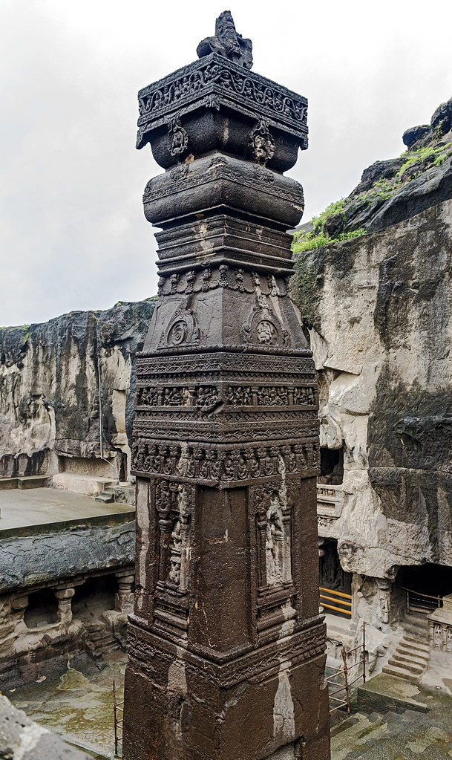
02
Visiting Ellora

Slide 8
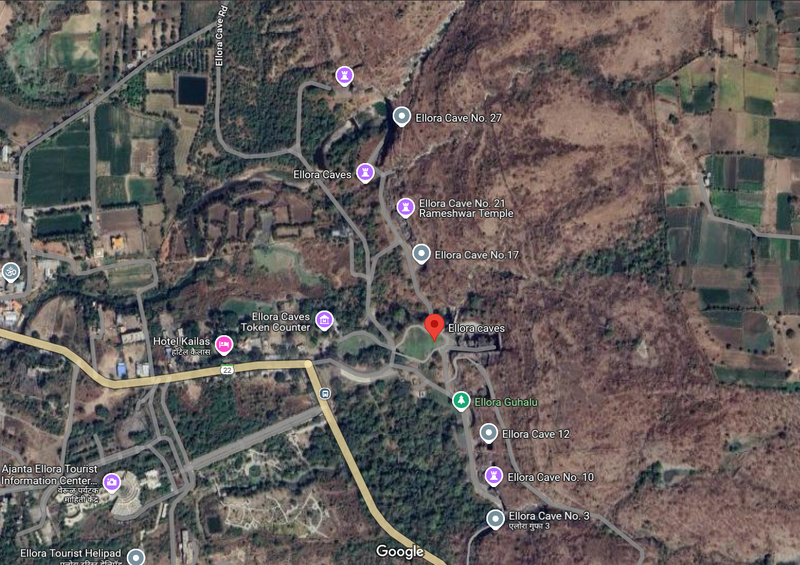
Location
Located about 30 kilometers from Chhatrapati Sambhajinagar (formerly Aurangabad).
Ellora Caves are carved into the hills of the Western Ghats, offering stunning views and easy access for visitors.

Slide 9
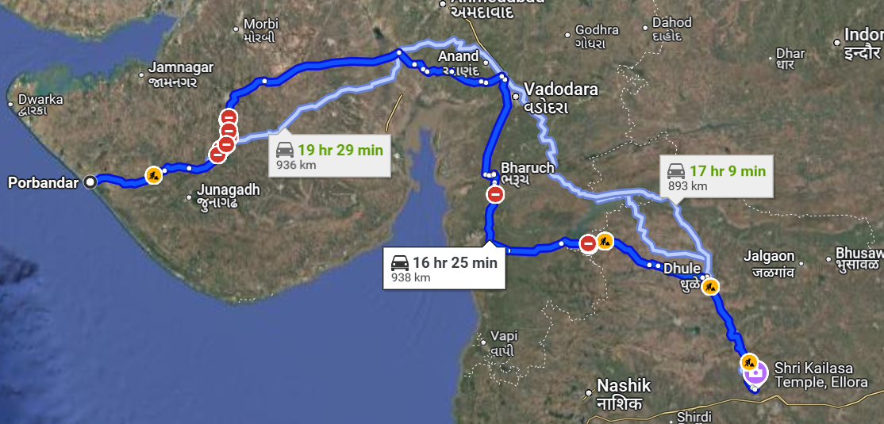
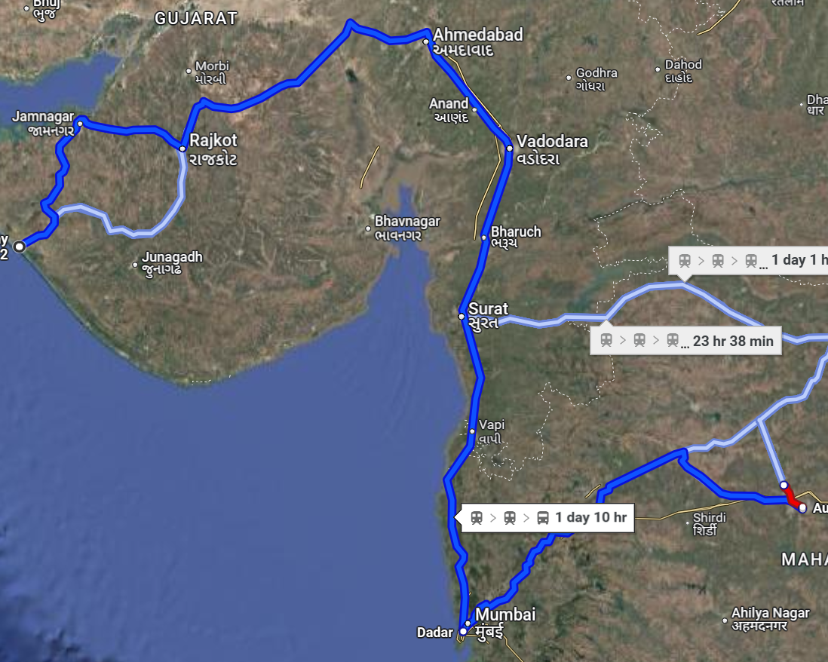
Route (via Road) Route (via Train)

Slide 10
Route from Porbandar
By Road:
1000 – 1100km
Route: Porbandar → Rajkot → Ahmedabad → Nashik → Chhatrapati Sambhajinagar → Ellora
18-20 hours
By Train:
Route: Porbandar → Ahmedabad → Chhatrapati Sambhajinagar → Taxi/Bus to Ellora
20-24 hours
By Air:
Route: Porbandar → Bus/Train to Ahmedabad → Flight to Chhatrapati Sambhajinagar → Taxi/Bus to Ellora
8-10 hours (Road), 1-2 hours (Flight)

Slide 11
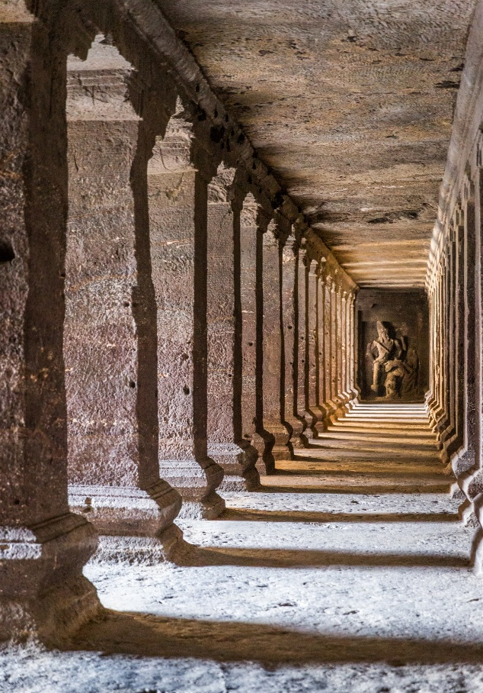
Conclusion
Represent India’s artistic genius, religious harmony, and engineering brilliance.
Showcase a range from the majestic Kailasa Temple to the serene Jain caves.
Reflect how ancient craftsmen carved culture, faith, and history into stone.
It is a journey through India’s soul preserved in rock.

Slide 12
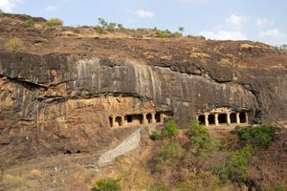
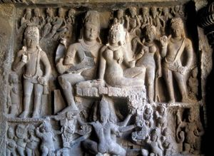
Further reads
UNESCO World Heritage Site – Ellora Caves
Archaeological Survey of India – Ellora Caves
Ministry of Culture – Ellora Caves
Britannica – Ellora Caves
Wikipedia – Ellora Caves

Slide 13
Thank You!
Presentation by
Asvini Kumar Pandey
Roll no. 02, Class XII
Under the guidance of
Ms. Vandana Ozi ma’am

